Slide 1

Efficient Wideband Spectrum Sensing Using MEMS Acoustic Resonators
Junfeng Guan, Jitian Zhang, Ruochen Lu, Hyungjoo Seo,
Jin Zhou, Songbin Gong, Haitham Hassanieh

Slide 2



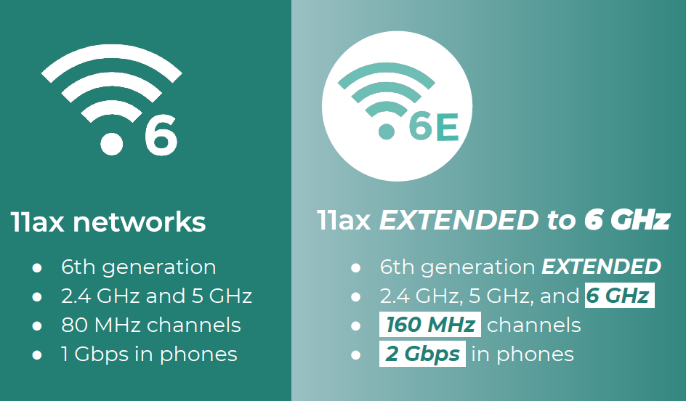








Changes in the Wireless Spectrum
January 2020
Authorized full commercial deployment in 3.5 GHz CBRS band
April 2020
Released 1.2 GHz unlicensed spectrum in 6 GHz (Wi-Fi 6E)
October 2020
Expanded unlicensed wireless operations in TV White Spaces
Citizens Broadband Radio Service (CBRS) band
Tier 1: Incumbent Access
Tier 2: Priority Access License
Tier 3: General Authorized Access

Slide 3
Improve Spectrum Use Efficient Through Sharing
Citizens Broadband Radio Service (CBRS) band
Conventional per-band
Spectrum access paradigm
Tier 1: Incumbent Access
Sharing
TV White Spaces
CBRS band
Tier 2: Priority Access License
Wi-Fi 6E
Tier 3: General Authorized Access
Dynamic spectrum sharing scheme
Exploit previously underutilized spectrum
Accommodate new wireless services

Slide 4
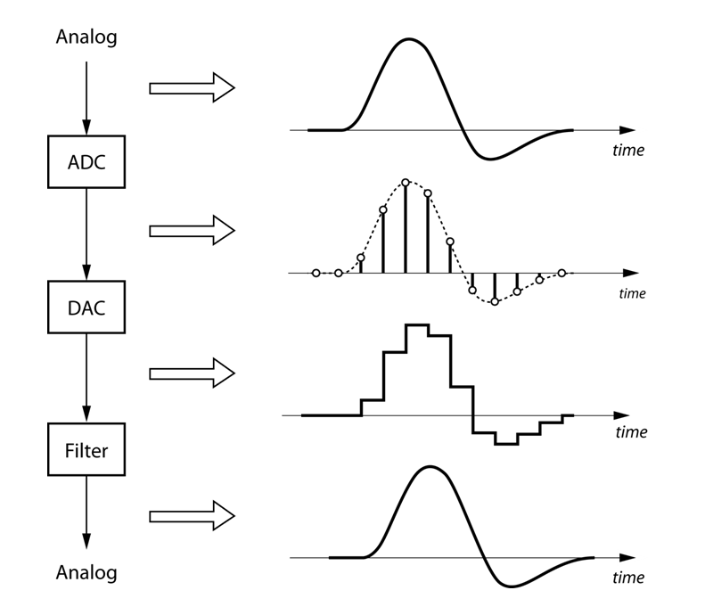
Enabling Dynamic Spectrum Sharing
Requirement for unlicensed devices:
Find and access momentarily idle channels
Sense wideband (100s of MHz to GHz) spectrum in real-time
Sampling at the Nyquist sampling rate
High-speed
ADC
Expensive
High power consumption
Real-time wideband spectrum sensing is
challenging for mobile and IoT devices

Slide 5
Existing Spectrum Sensing Technologies
Frequency Sweeping
Sequential scanning
- monitoring each narrow band for a short period time.
Cannot continuously sense all bands in real-time.
Easily miss highly dynamic and fleeting signals such as radar waveforms.
Compressive Sensing or Sparse Fourier Transform Algorithms
Only work when the spectrum is sparsely occupied.
Defeat the purpose of efficiently utilizing the spectrum.

Slide 6
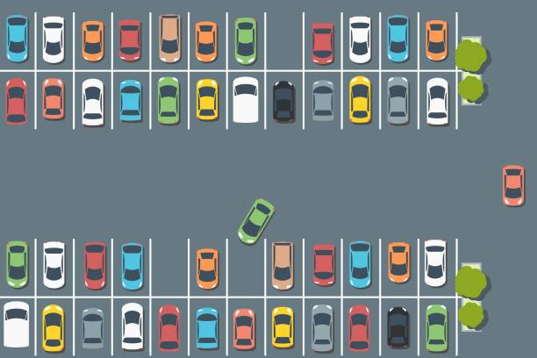
New Spectrum Sensing Strategy
Vacant Channel
Finding a vacant wireless channel as
finding an open spot in a parking lot.

Slide 7
New Spectrum Sensing Strategy

Slide 8
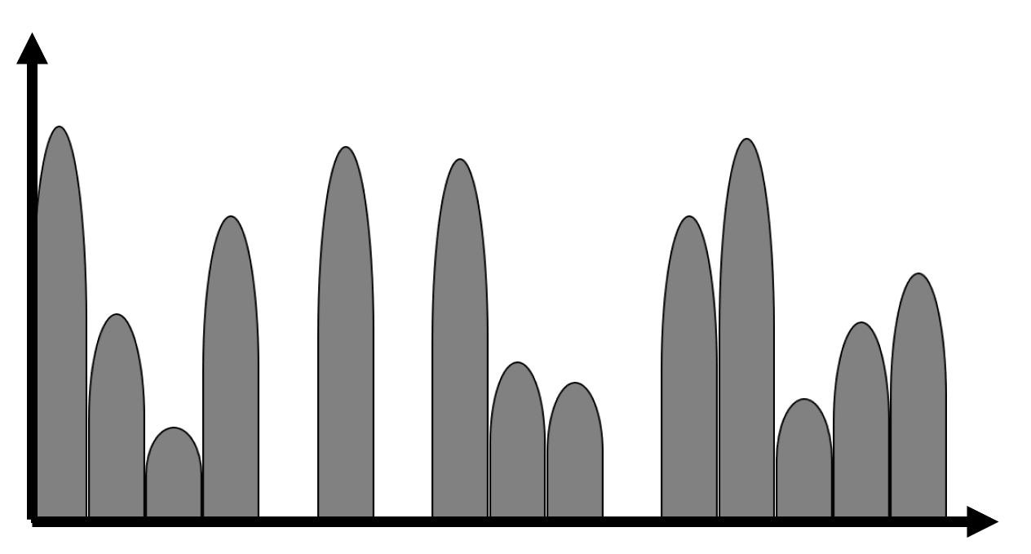
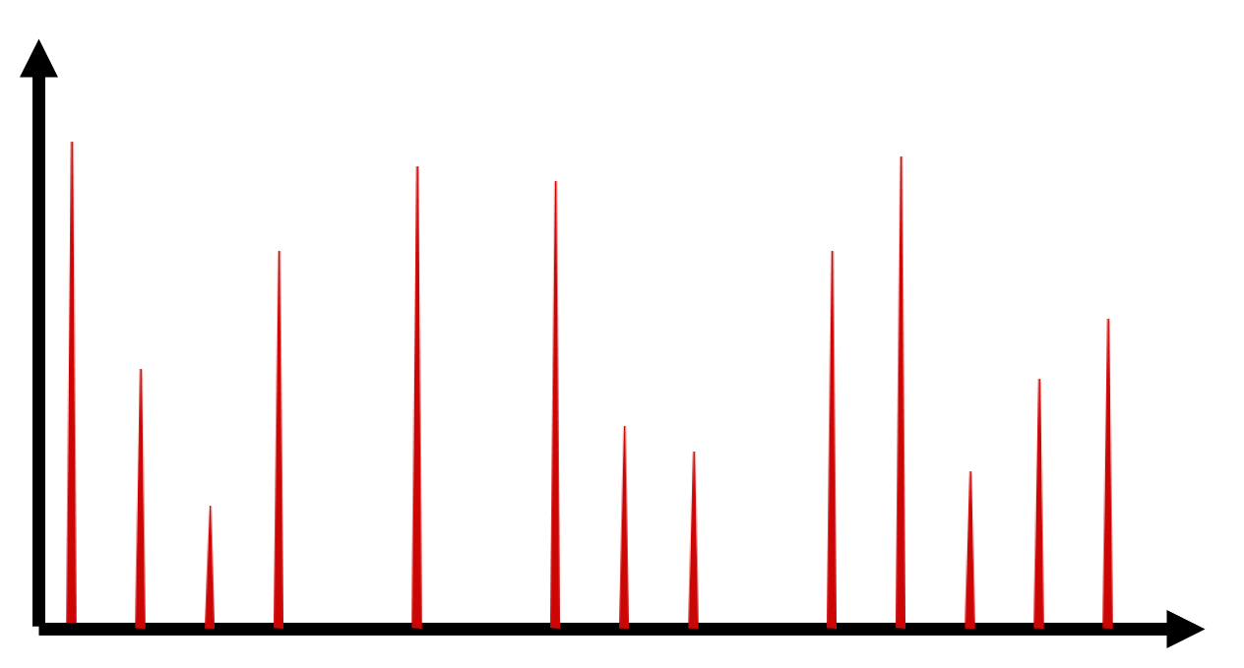
S³ – Spectrum Sensing Spike-Train
Sampling along the frequency axis
Detected Spectrum Occupancy
Monitor sampled
fraction of bandwidth
Densely Occupied Wideband Spectrum
Sparse Frequency Sampled Spectrum
Features of S³:
Real-time occupancy
Wideband
8.5x below Nyquist sampling → Low power consumption
Densely occupied spectrum

Slide 9
S³ – Spectrum Sensing Spike-Train
Sampling along the frequency axis
Detected Spectrum Occupancy
Monitor sampled
fraction of bandwidth
How can we sample a spectrum along the frequency axis?
Densely Occupied Wideband Spectrum
Sparse Frequency Sampled Spectrum
Features of S³:
Real-time occupancy
Wideband
8.5x below Nyquist sampling → Low power consumption
Densely occupied spectrum

Slide 10
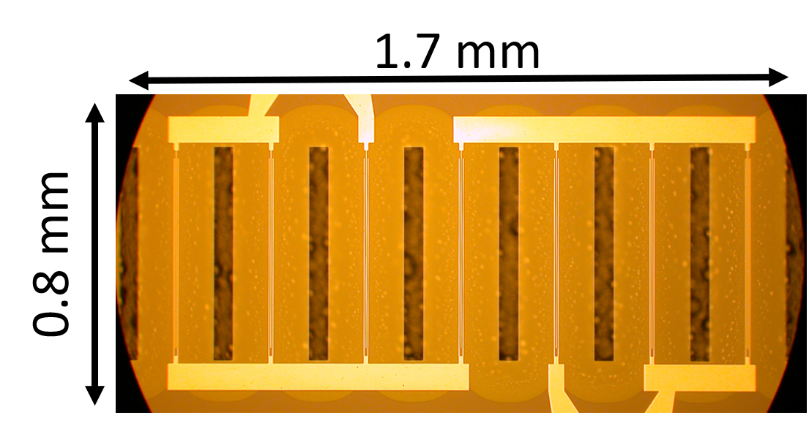
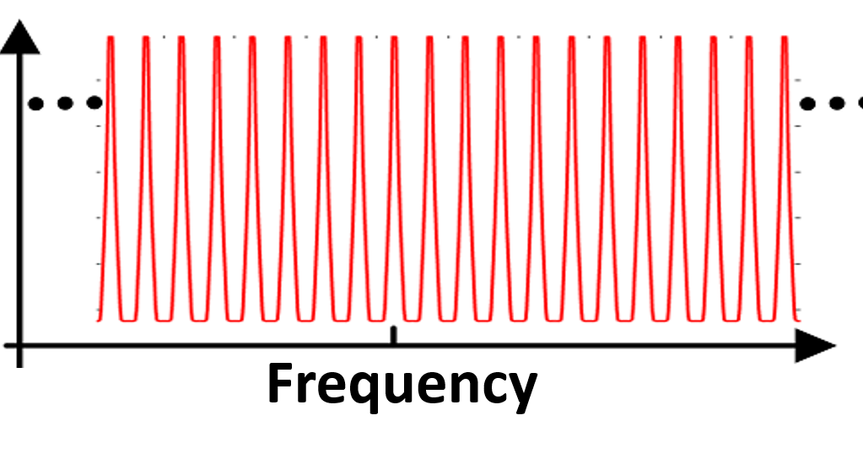
Enabled of Frequency Sampling
Sample the signal below the Nyquist sampling rate
and still be recover the channel occupancies.
Spike-Train Filter
Densely Occupied Wideband Spectrum
Sparse Frequency Sampled Spectrum
Microscope Image
Frequency Response
Narrow, sharp, and periodic passbands

Slide 11
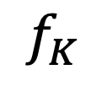
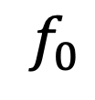
Spike-Train Filter Created by MEMS Acoustic Resonators
MEMS: Micro-Electro-Mechanical Systems
Resonance frequencies
determined by geometry of the piezoelectric material.
$$f_{0}$$
$$f_{K}$$
Output
Acoustic to RF
Electrodes
RF to Acoustic
Piezoelectric Thin Film
Input
Width W

Slide 12
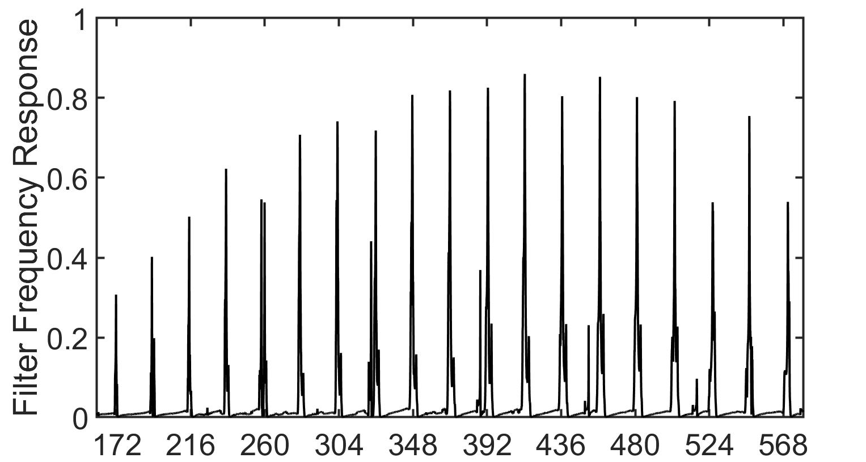
Spike-Train Filter Created by MEMS Acoustic Resonators
19 spikes
22MHz spacing
418MHz bandwidth

Slide 13
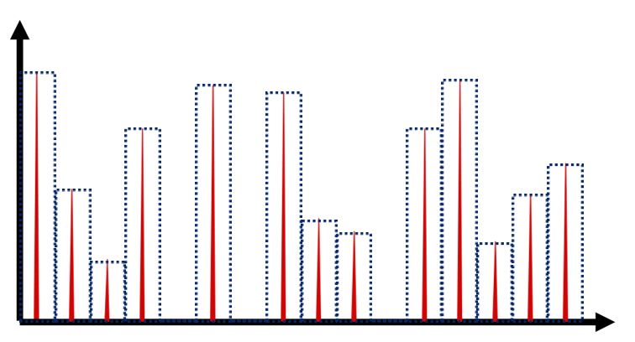
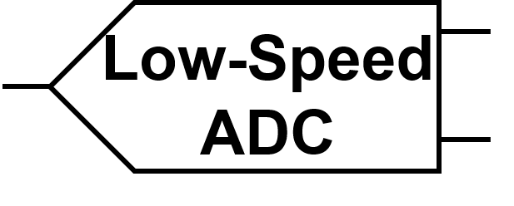
Recover Spectrum Occupancy
S³
Recovery Algorithm
Sparse Frequency
Sampled Spectrum
Detected Spectrum Occupancy
Sub-Nyquist
Sampling
Challenge 1:
Reconstructing wideband spectrum occupancy
from sub-Nyquist sampled time-domain signals.
Sampling below the Nyquist rate results in Aliasing
Sub-Nyquist Sampling
Low-Speed
ADC
S³ Recovery Algorithm
Leveraging
Structured Sparsity
Aliasing
Digitized Spectrum
with Ambiguity & Collisions
Detected Spectrum Occupancy
Low-Speed
ADC
Resolving
Ambiguity & Collisions
Sub-Nyquist Sampling
at a different rate

Slide 14
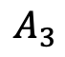
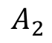
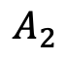
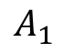
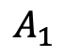

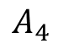

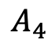
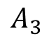
Co-prime sub-sampling factor avoids frequency collisions
Avoid Frequency Collisions
Spike-Train
$$A_{1}$$
$$A_{2}$$
$$A_{3}$$
$$A_{4}$$
$$A_{1}$$
$$A_{2}$$
$$A_{3}$$
$$A_{4}$$
$$X(f)$$
Frequency
Frequency
0
1
2
3
4
5
6
7
8
9
10
11
0
1
2
3
4
5
6
7
8
9
10
11
Collision
Sub-sample by factor of 3
(co-prime with
number of spikes K)
Sub-sample by factor of 2
$$Y(f)$$
0
1
2
3
4
5
0
1
2
3
Structured Sparsity Pattern
Co-prime sub-sampling factor guarantees no collisions

Slide 15
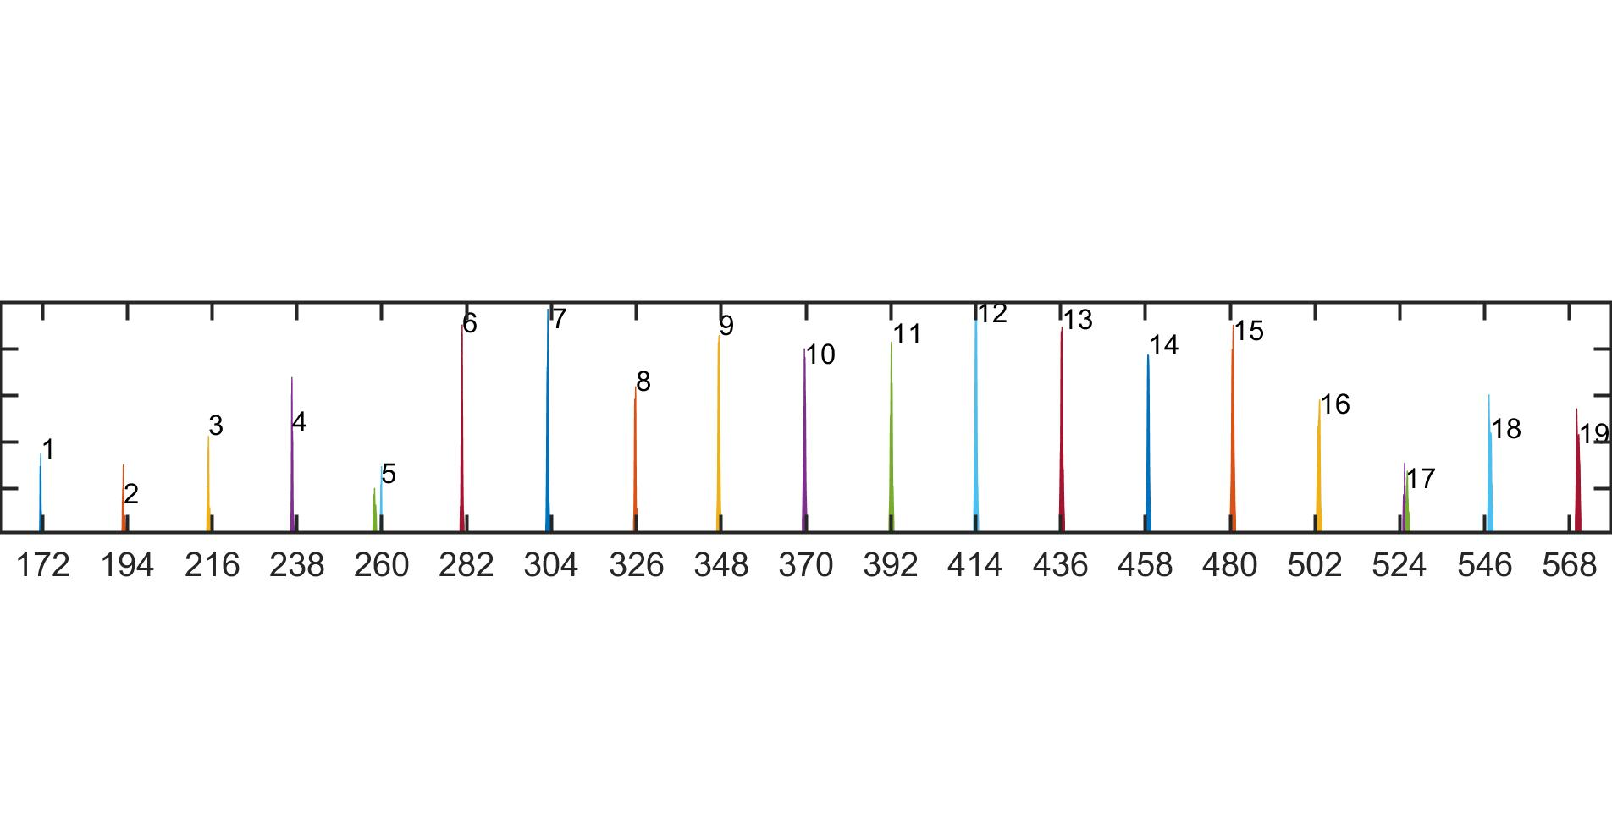
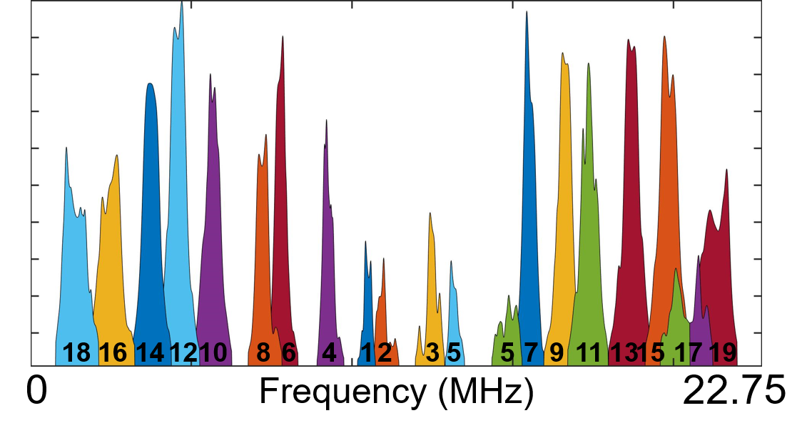
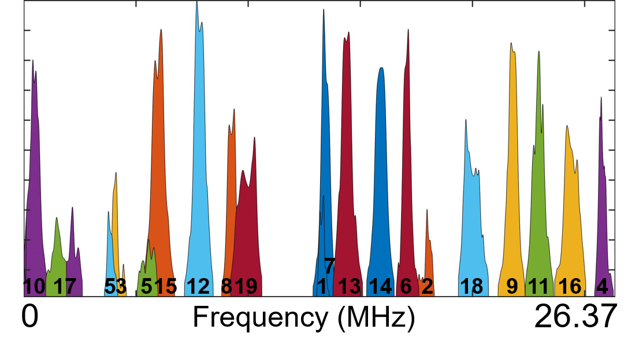
S³ with Non-Ideal Spike-Train Filter
Challenge 2: Non-ideal spike-train filter in practice.
Frequency Response
(Normalized)
Different sampling rates exhibit frequency collisions between different spikes
(MHz)
Frequency Collision
Not in Collision
Sampling rate = 45.5 MHz
Sampling rate = 52.74 MHz

Slide 16
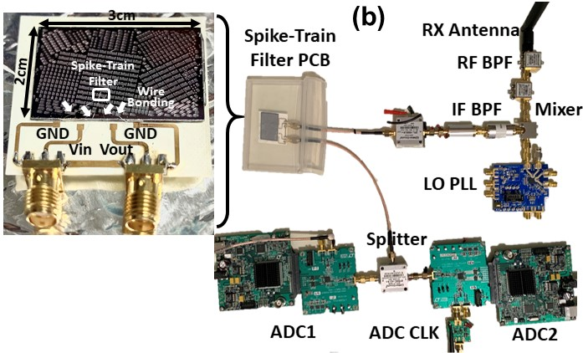
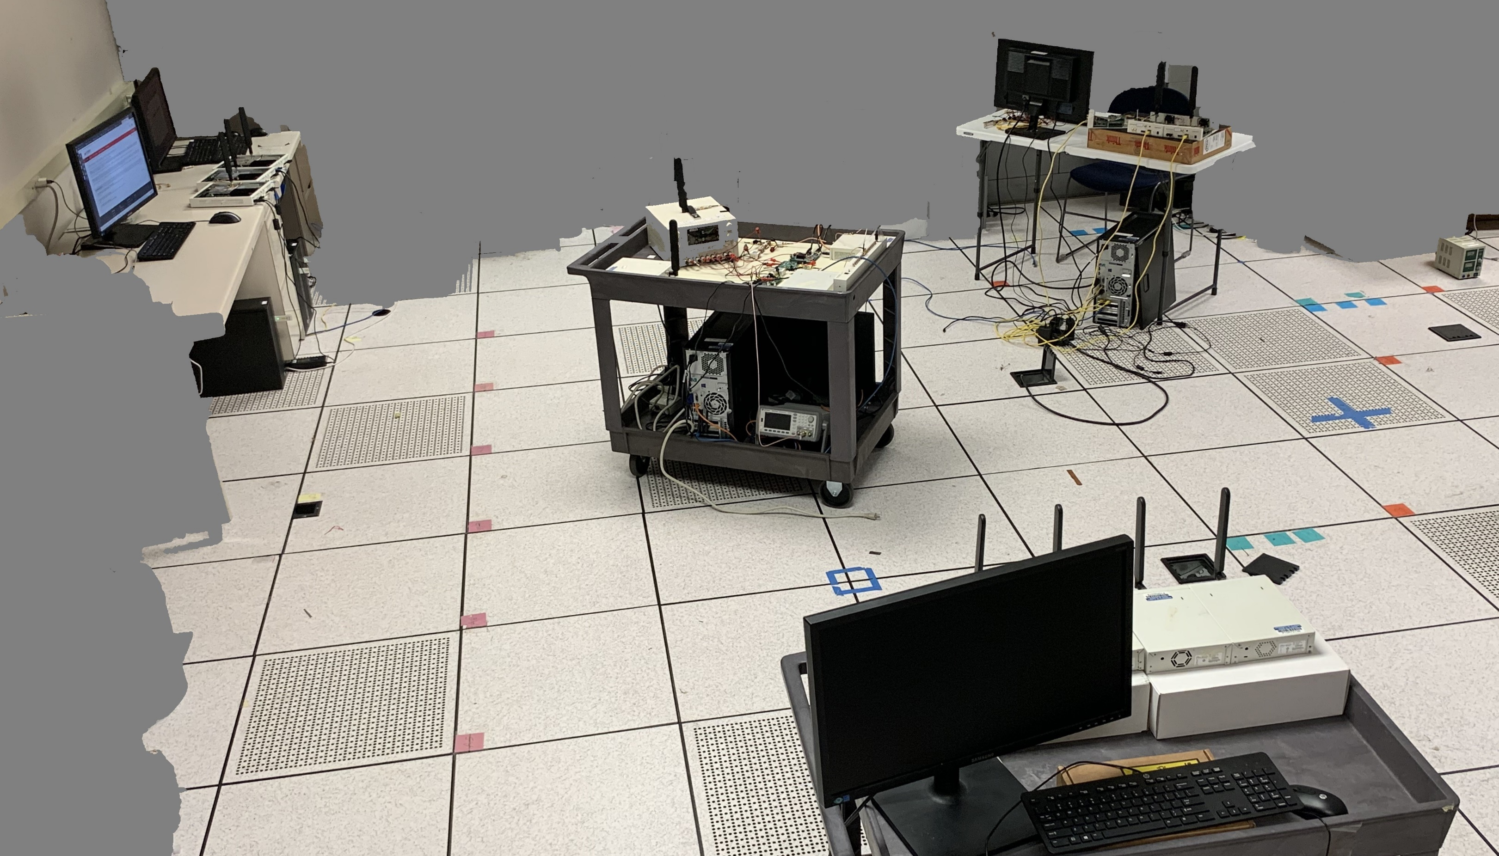
Evaluation Using Spectrum Sensing Testbed
TX USRPs
S³ Receiver
2.2m
TX USRPs
2.1m
2m
TX USRPs

Slide 17
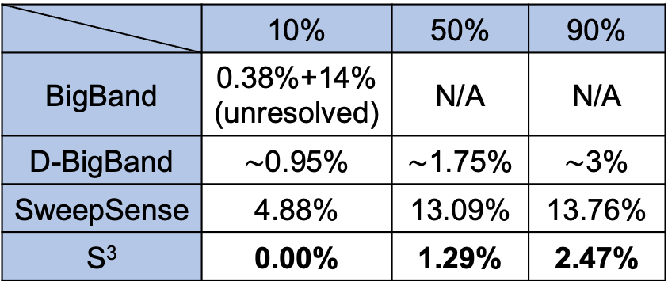
Occupancy Detection Accuracy
False Positive Rate: Percentage of empty bands that S³ incorrectly reports as occupied.
False Negative Rate: Percentage of occupied bands that S³ incorrectly reports as empty.
Comparison Against State-of-the-Art Prior Work
 | 10% | 50% | 90%
BigBand | 0.38%+14% (unresolved) | N/A | N/A
D-BigBand | $∼$0.95% | $∼$1.75% | $∼$3%
SweepSense | 4.88% | 13.09% | 13.76%
S³ | 0.00% | 1.29% | 2.47%

Slide 18
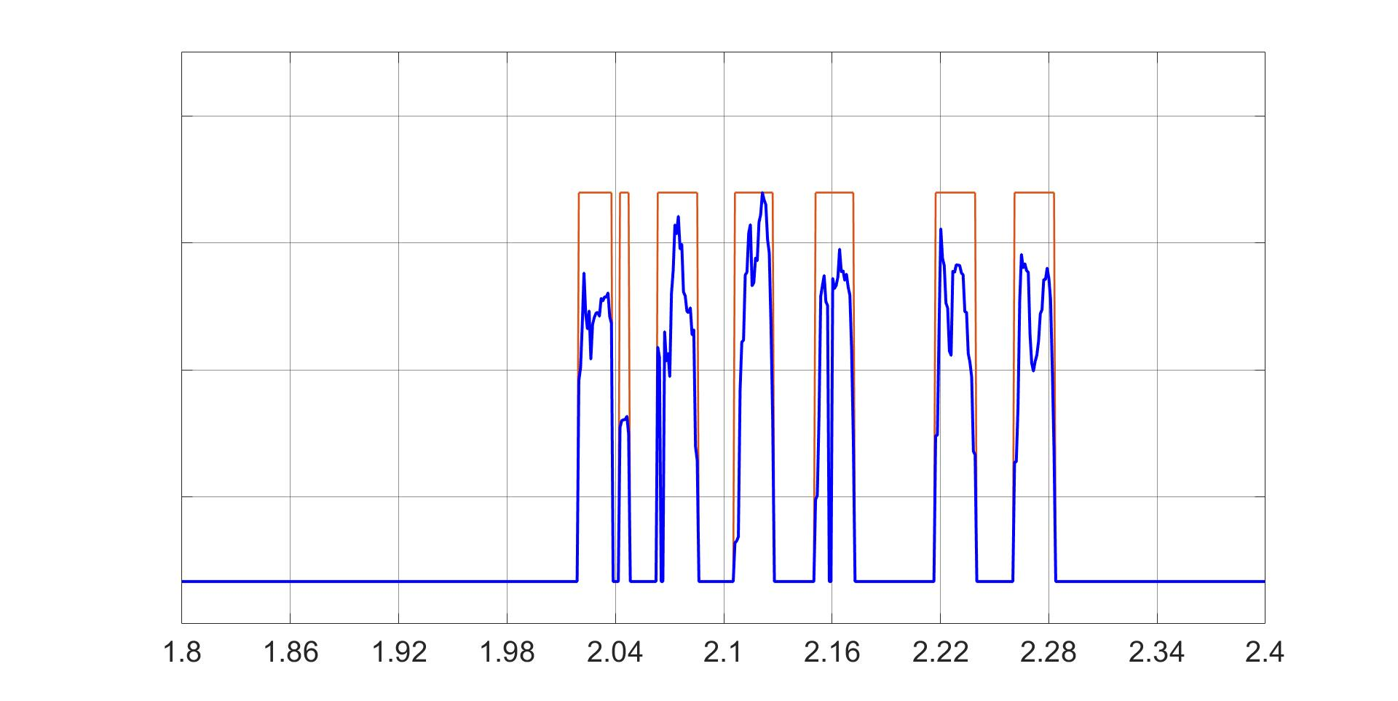
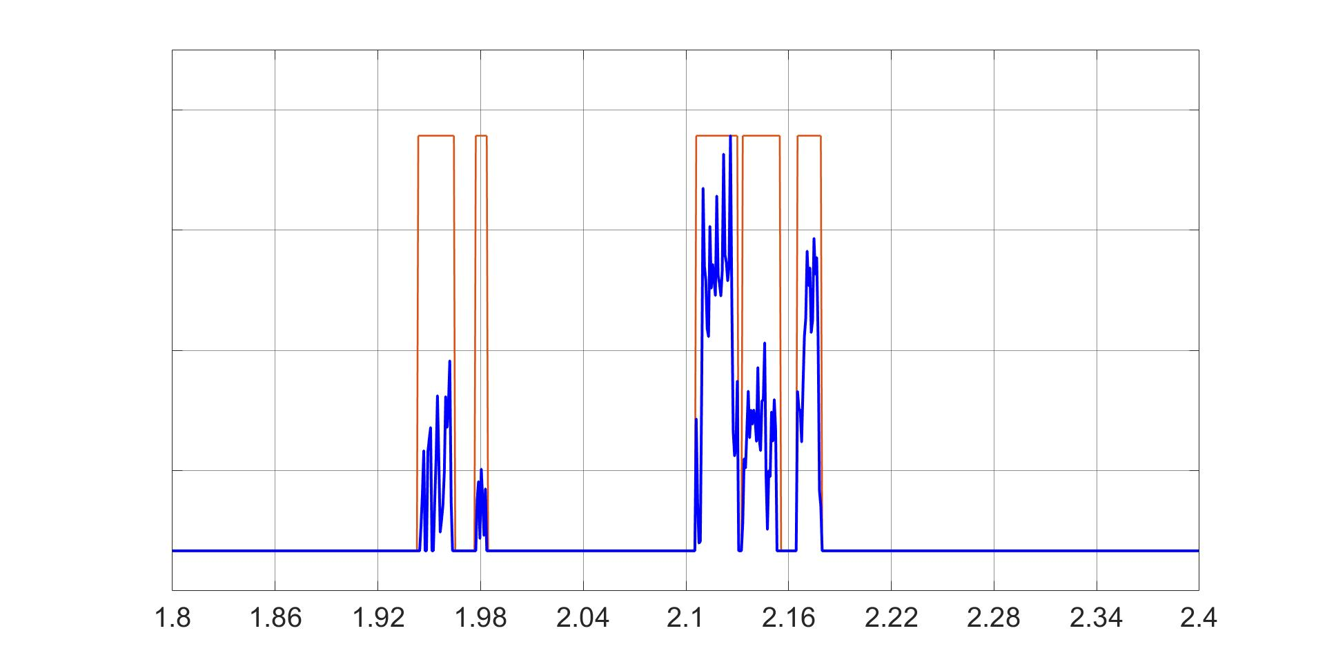
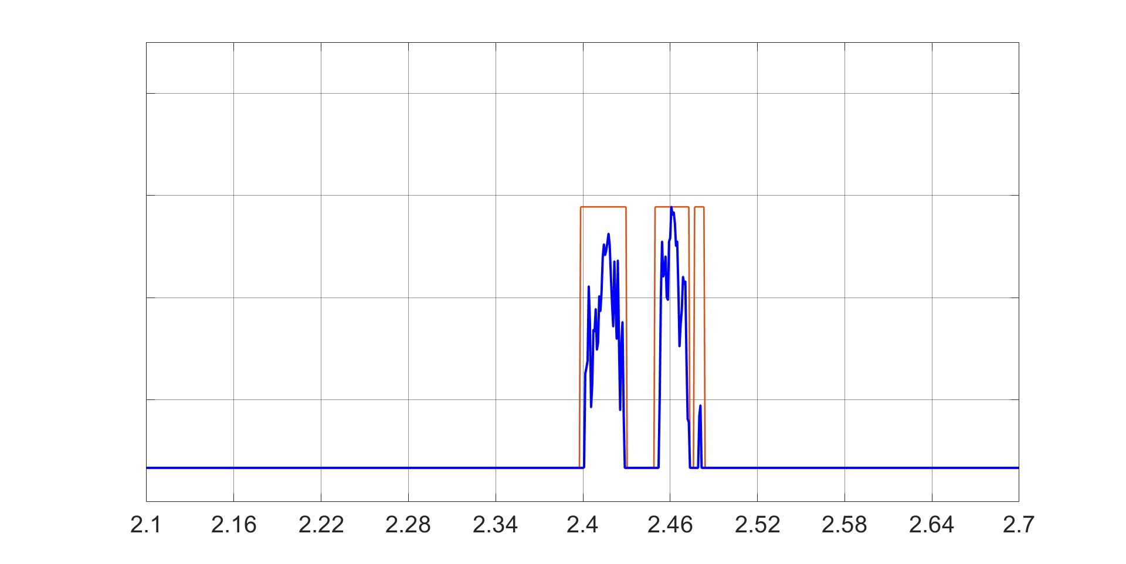
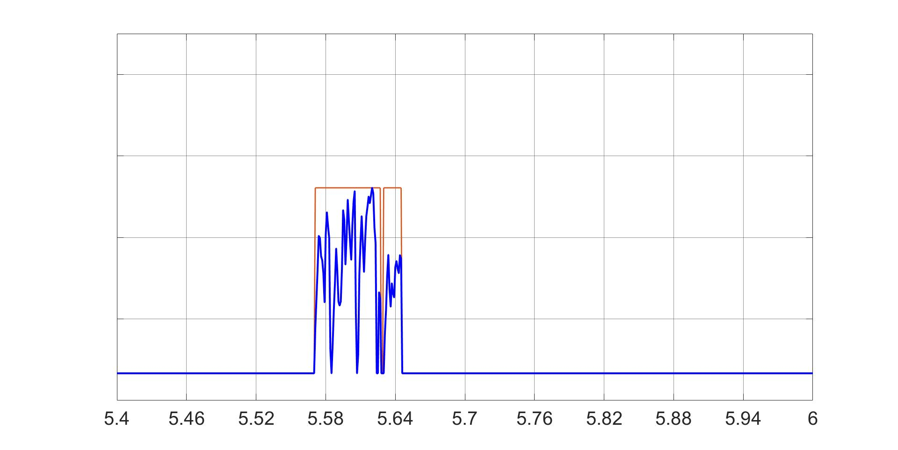
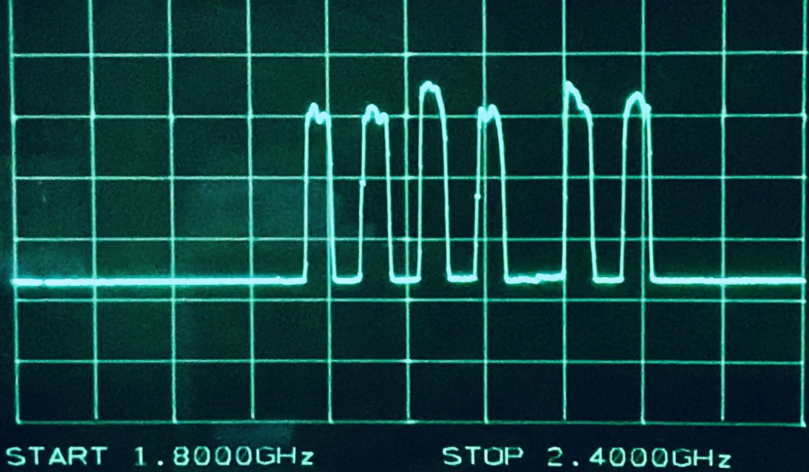
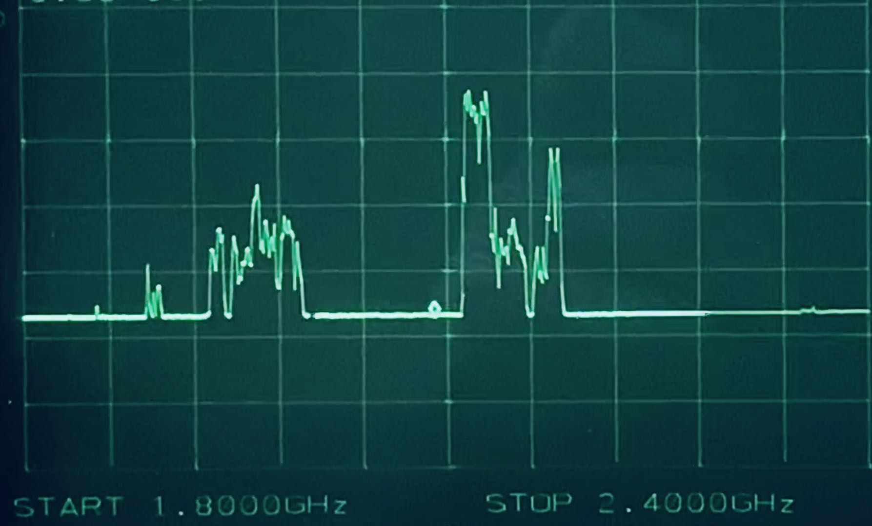
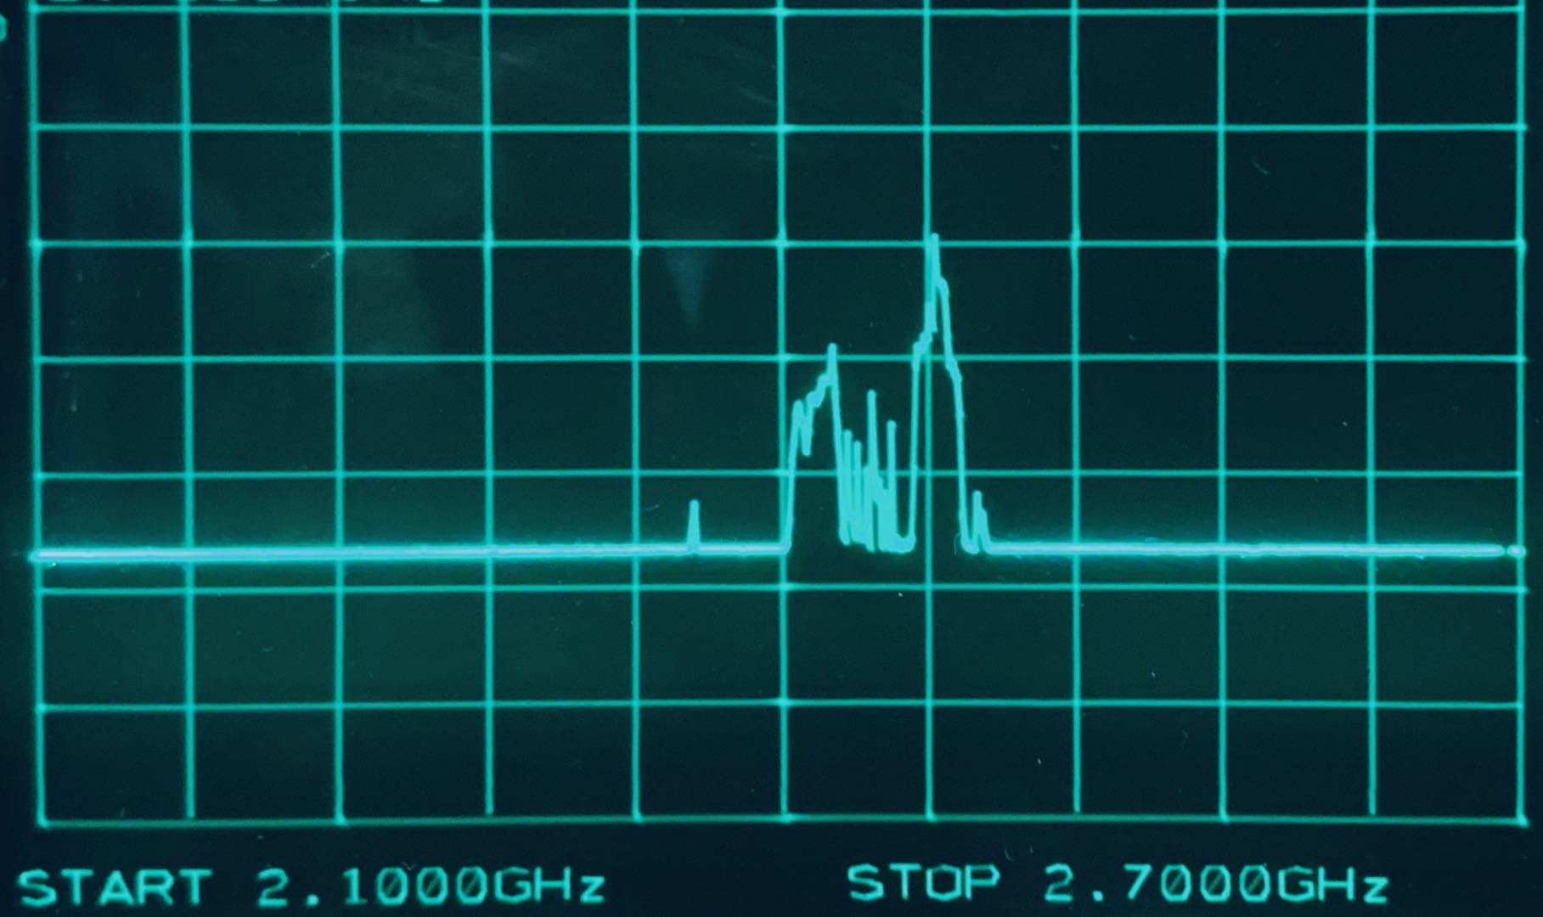
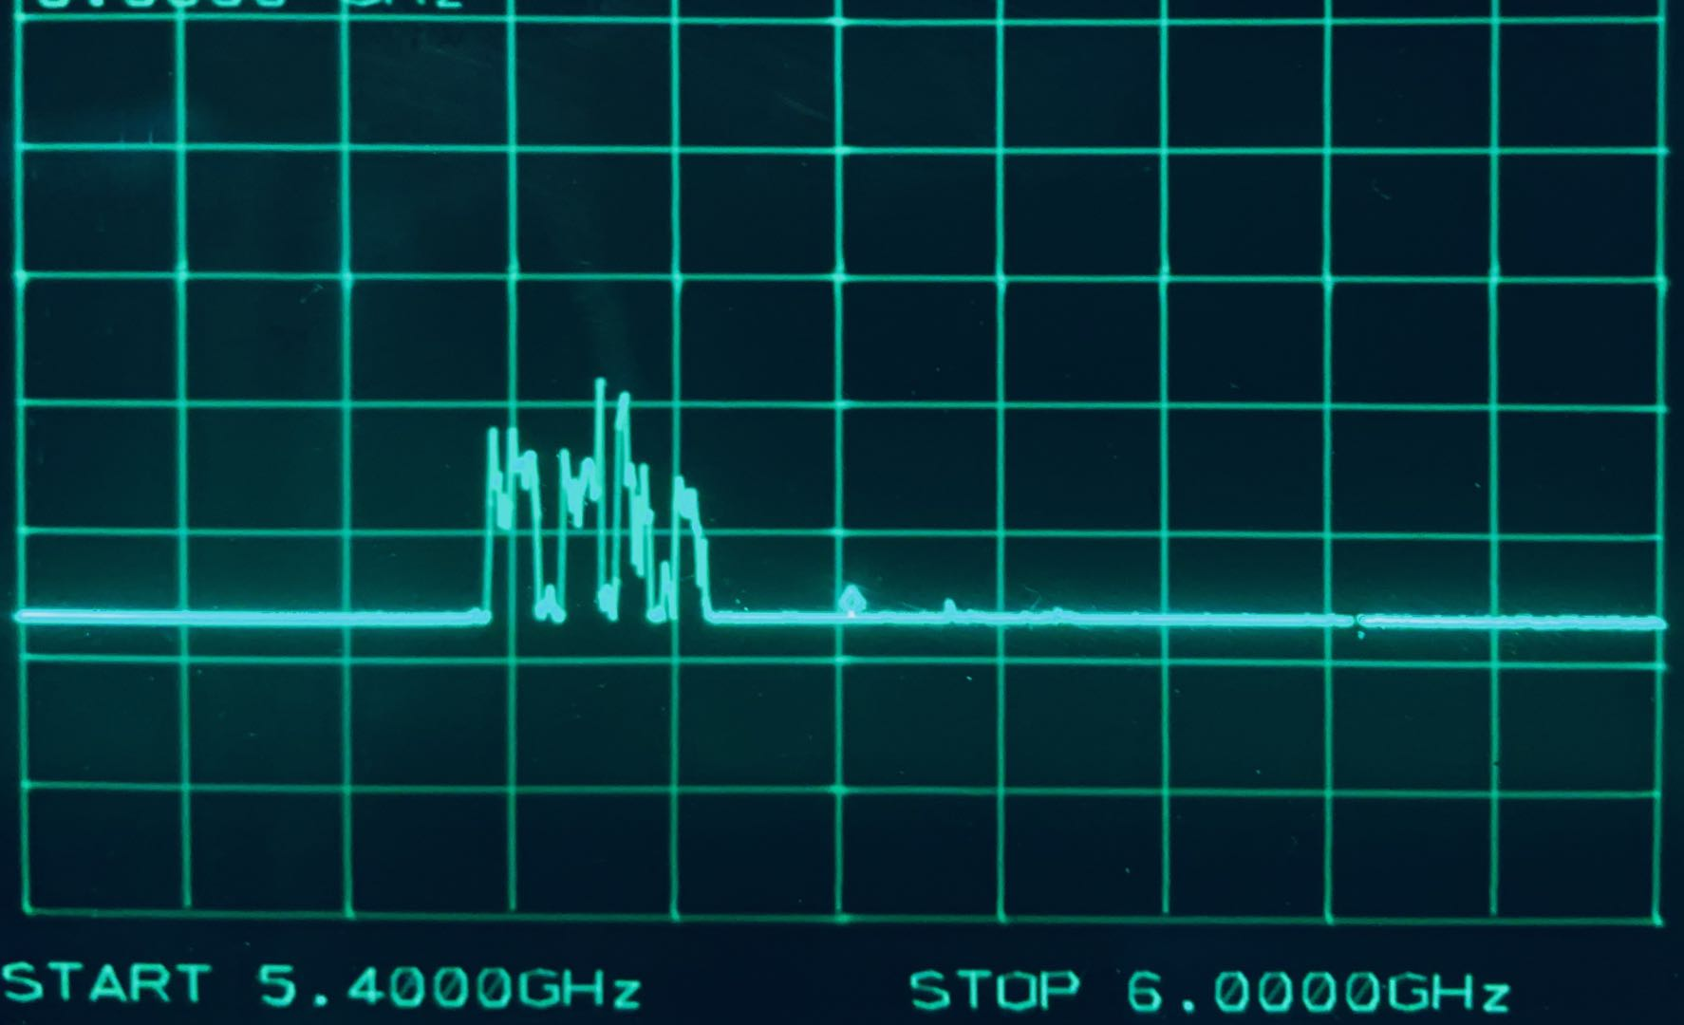
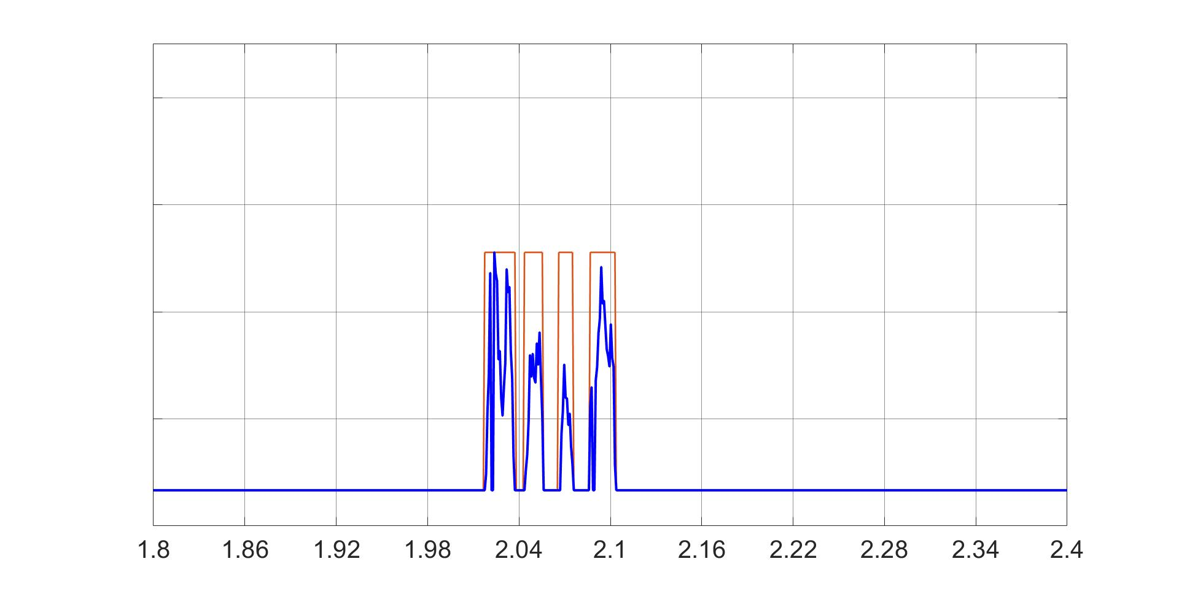
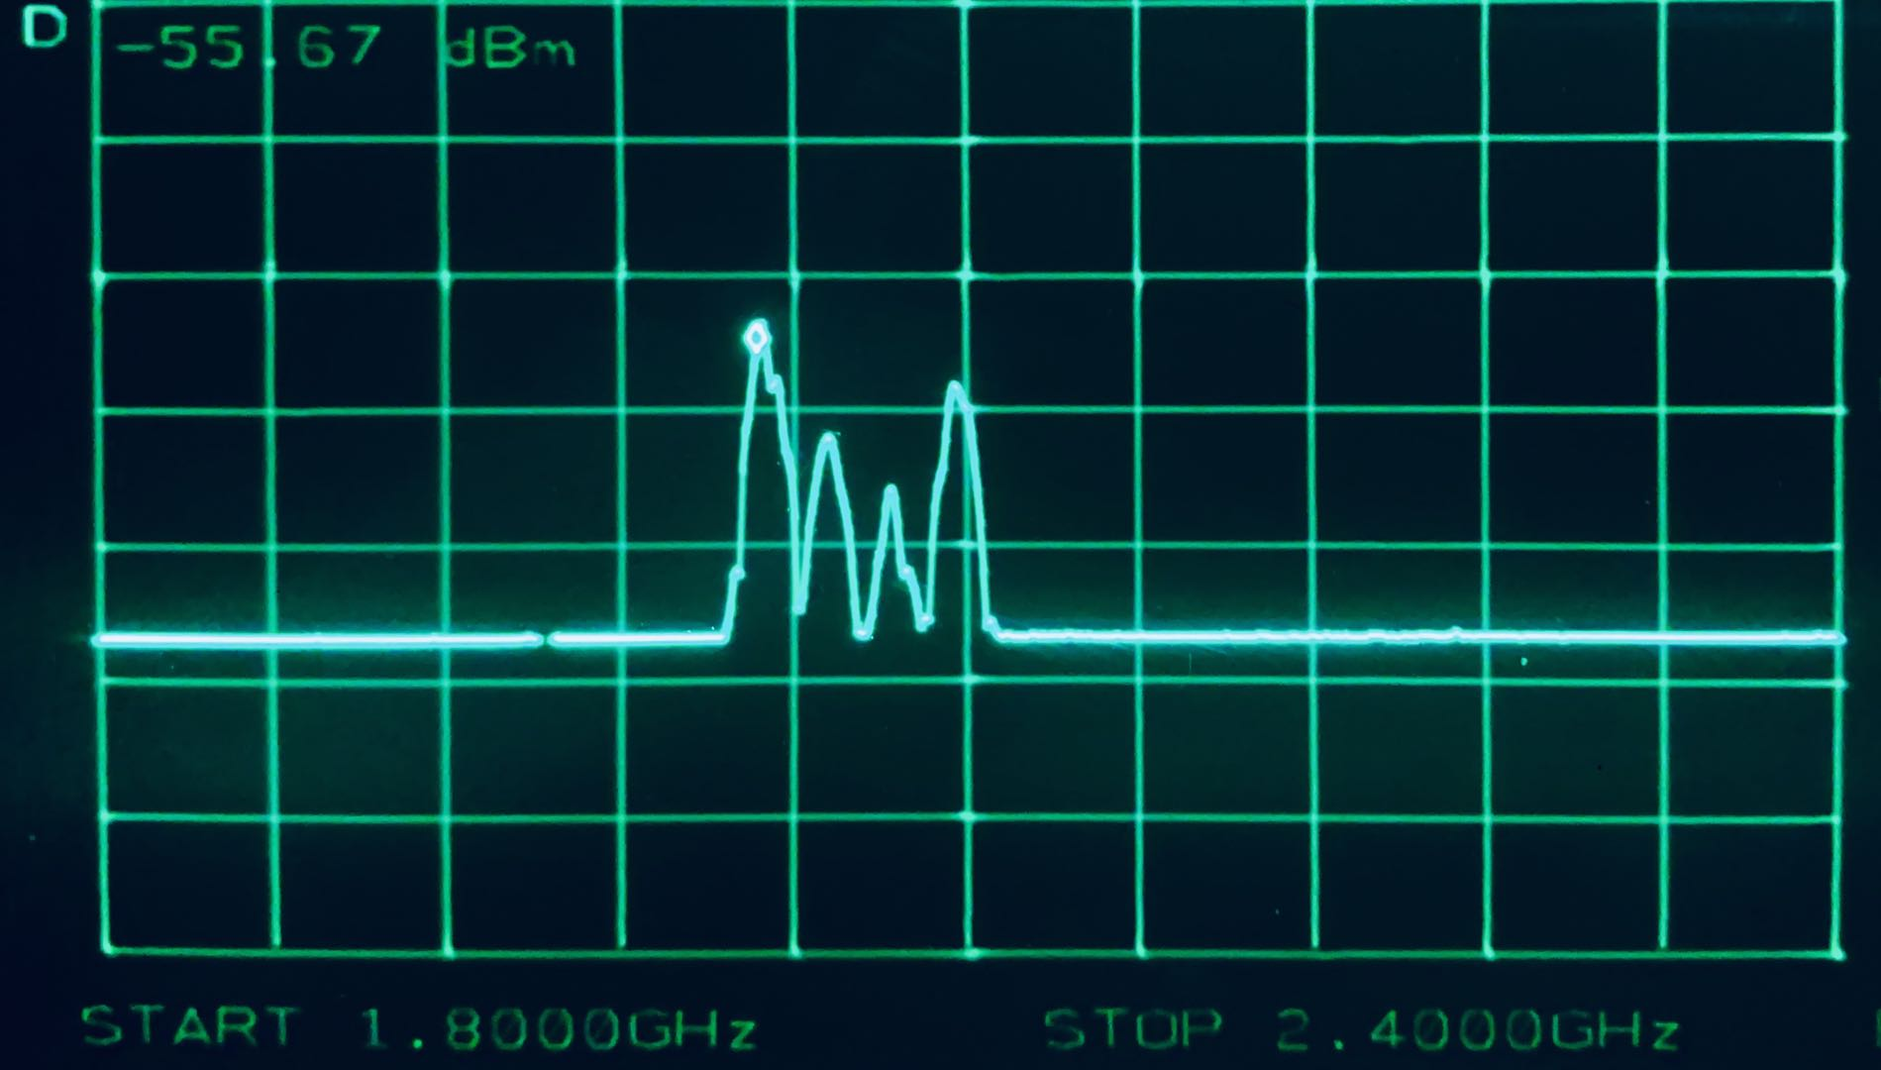
Extend S³ to Capture Power Spectral Density
GHz
Testbed 1.8~2.4 GHz
Outdoor 1.8~2.4 GHz
Indoor 2.1~2.7 GHz
Indoor 5.4~6 GHz
(a)
(b)
Power Spectrum Density Captured by S³
Power Spectral Density
(d)
Spike Occupancy
Spectrum Analyzer Ground Truth
Combining frequency sampling and sweeping

Slide 19
Conclusion
S³ – Spectrum Sensing Spike-Train:
Efficient real-time wideband spectrum sensing mechanism.
Can work in densely occupied spectrum.
Leverages RF MEMS filtering solution to enable sampling the spectrum along the frequency axis.
Can be extended to capture power spectral density.
For more details, please check out our paper:
https://www.usenix.org/conference/nsdi21/presentation/guan

